Slide 1

SDET Course
Design Patterns - Chain of Responsibility

Slide 2
3 Types of Design Patterns
Creational
Singleton
Builder
Prototype
Factory Method
Abstract Factory
Structural
Adapter
Composite
Proxy
Flyweight
Bridge
Facade
Decorator
Behavioral
Strategy
Observer
Command
Memento
State
Template Method
Mediator
Chain of Responsibility
Interpreter
Visitor
Iterator

Slide 3
Agenda
Description
Diagram
Code sample (Java)
Use cases

Slide 4
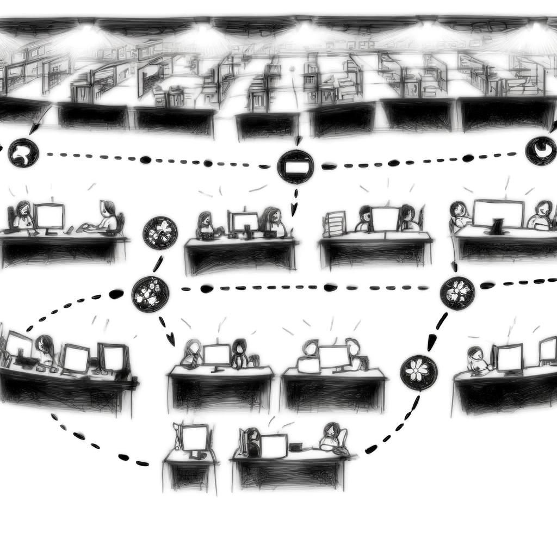
Description
Introduction - Let Me Transfer You

Slide 5
Description
The Chain of Responsibility design pattern is a behavioral design pattern used to pass the request along a chain of handlers. Upon receiving a request, each handler decides either to process the request or to pass it to the next handler in the chain. This pattern allows an object to send a command without knowing which object will handle the request. It effectively decouples the sender and the receiver by giving multiple objects a chance to handle the request. The chain can be dynamically composed at runtime, and the handlers in the chain do not need to know about the overall structure of the chain. This pattern is particularly useful when multiple objects can handle a request, but the specific handler isn’t determined a priori, thus promoting loose coupling and flexibility in the distribution of responsibilities.

Slide 6
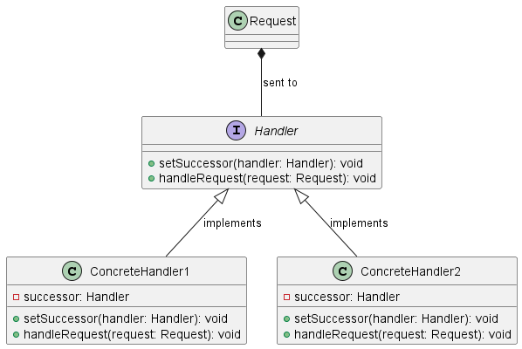
Class Diagram

Slide 7
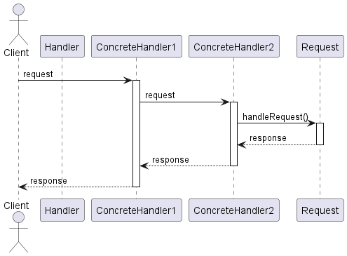
Sequence Diagram

Slide 8
Code Sample

Slide 9
Use cases
General
Logging Frameworks
Approval Processes
In Test Automation
Test Result Processing
Automated Test Fixtures (Junit 5 extensions)
Middleware for API Testing

Slide 10
Happy Coding

